Slide 1

Swarm‑Based Meta‑Heuristics for Multi‑Objective Route Optimisation in Micromobility Systems
By Ben Crane and Hemandh Babu Babu
Supervised by Prof Suzanne Little

Slide 2
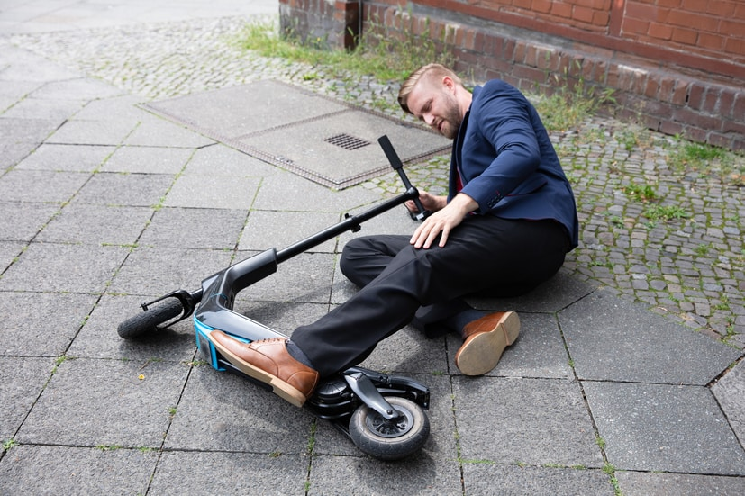
Introduction and Motivation
Create a route algorithm to deliver shortest & safest route between two points
Problems:
Micromobility system usage is increasing [1] but safety has failed to keep up [2]
Factors like poor infrastructure, conflicting inter-jurisdictional regulations & rider behaviour [3] play a part in the unsafe nature of micromobility systems
Approach:
Swarm‑based routing using Particle Swarm, Ant Colony & Wolf Pack Optimisation
Optimises Metrics e.g. route distance, safety, risk reduction & computational efficiency.
Performance benchmarked against Dijkstra & A* pathfinding methods.
Notes:
Real-World Applications:
Micromobility User: User can generate two routes and choose one to their liking (from source to destination)
Government: Propose this as a sustainable solution to halt the rising accident rates

Slide 3
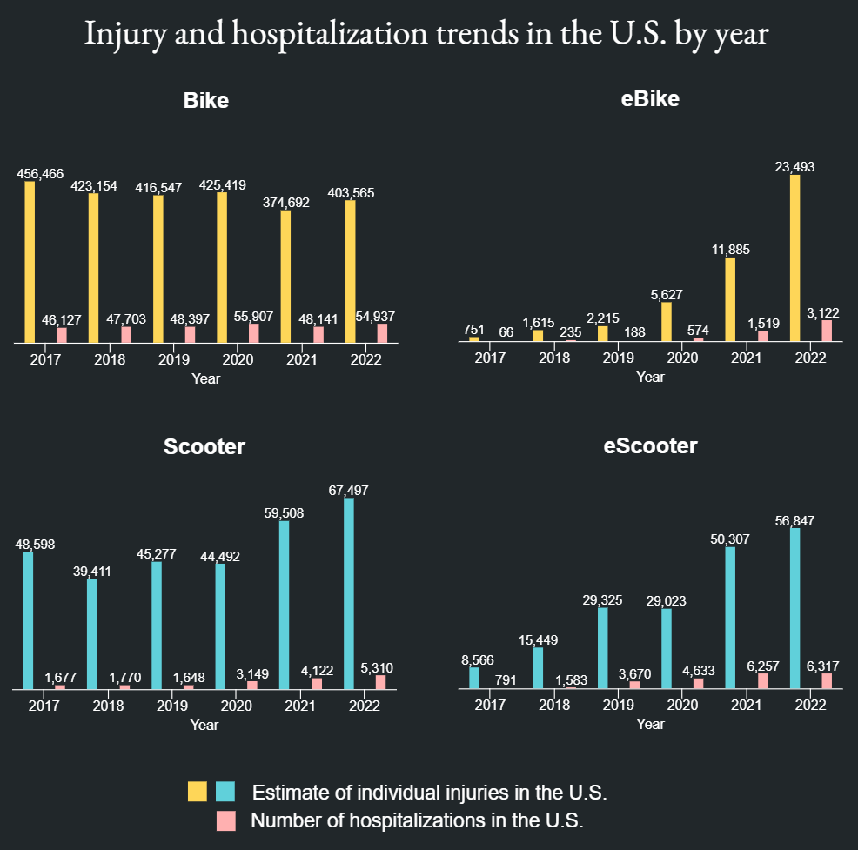
UCSF data shows rising eBike/eScooter injuries in the U.S. (2017–2022) [2].

Slide 4
Design Parameters & Research Questions
Design Parameters
Inputs: Traffic accident data with standardised dates & OpenStreetMap IDs (converted from coordinates)
Desired Outputs: HTML map of the route and command line interface of the result information with the main factors measured
Research Questions
RQ1: What is the impact of data availability on the performance of meta-heuristic route algorithms for micromobility safety?
RQ2: To what extent can swarming algorithms reduce user risk without increasing trip distance?
Computational Efficiency
(Time Duration)
Safety Improvements (between the algorithms)
Relative Risk Reduction (between algorithms)

Slide 5
Background and related works
Ridership reached record highs on micromobility systems according to NABSA (225M trips in 2024 [4])
Micromobility research focuses on ridership and injuries, not routing safety:
[5] combined YOLO v5 object detection with semantic segmentation of streetscapes & street-level scoring tool. 2 faults: outdated/ blurry imagery & scoring is preference-blind.
[6] shows risk exposure reduction possible, but with inconsistent/ non-standardised measuring tools plus biased user behavioural surveys.
Safety research ignores rider preferences in deciding recommended routes chosen.
Swarm algorithms are ideal for Multi-Objective Optimisation Problems under incomplete info.
Three (together) tackle above failures:
PSO shown to be good for cluster routing in Industrial Sensor Networks [7] (sparse-data case).
ACO applied to 3D pipeline layout [8] (tractability case).
WPO to deal with annual leave scheduling, under business constraints [9] (preference case).
None has been applied to micromobility route safety [10] [11], but together they cover what a scoring method working from degraded street data, a large route space and rider preference requires.

Slide 6
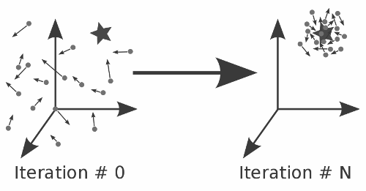
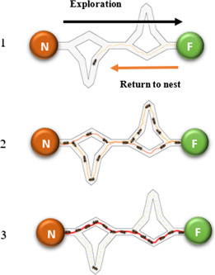
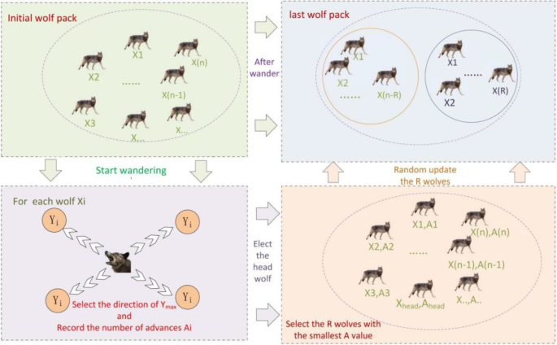
Particle Swarm Optimisation
Ant Colony Optimisation
Wolf Pack Optimisation

Slide 7
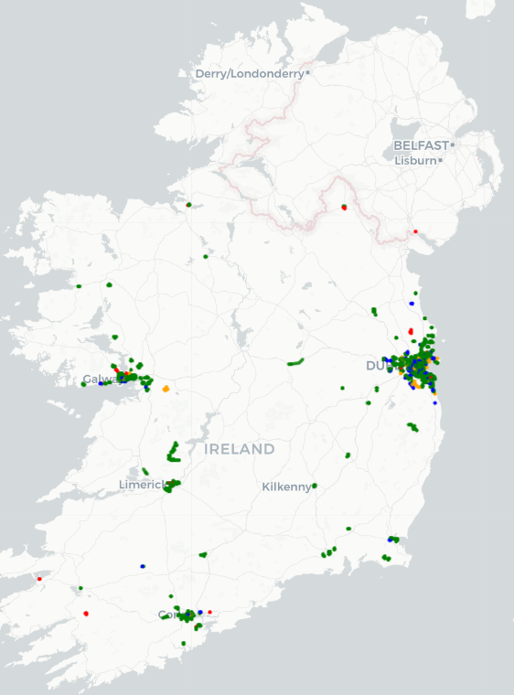

Methodology
Data from Dublin Active Travel Collision Tracker (Dublin Inquirer & UCD Spatial Dynamics Lab)
Incidents had date standardised - incidents before 2020 were removed.
OpenStreetMap data obtained and incident coordinates -> OSM IDs for mapping.
Using Python, Networkx, OSMNX & Python Folium, HTML maps created to choose testing routes.
Standard algorithms created with Python, tested with city, start, end destination at cmd.
Equivalent Google Map routes obtained & compared to these generated routes.
Swarming algs compared & contrasted (time taken, route distance, safety gains, risk reduction).
Algorithms tested for RT performance by excluding & including incident data as routing algorithms generated routes to compare its features/ observe improvements.

Slide 8
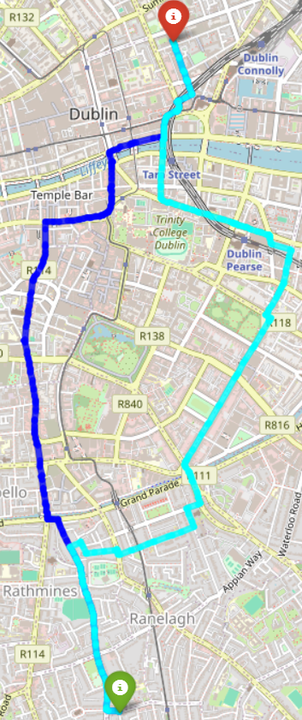
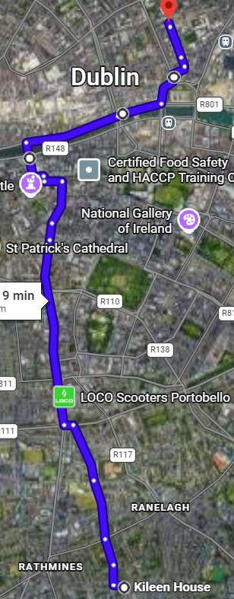
Routes Generated
Algorithm Generated Route (blue = shortest, cyan = safest)
Google Maps equivalent for the shortest route

Slide 9
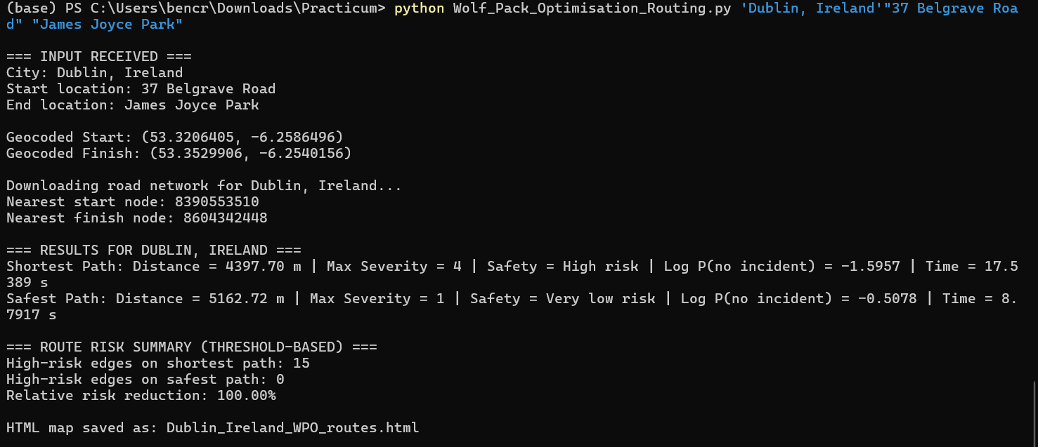
CLI displays runtime, safety gain, risk reduction & route distance.

Slide 10
Why the techniques were used
We compare conventional & swarm algorithms for safety-aware micromobility routing.
Dijkstra & A*
Deterministic baseline
Exhaustive search over non-negative weights for optimal path
A* adds admissible great-circle heuristic: narrows search while optimising distance
Particle Swarm
Lightweight & real-time friendly
Just needs simple fitness signal, not rich prior network model
Velocity => mutation (splice/swap) for discrete street graphs
Ant Colony
Learns through reinforcement
Pheromone trails for experience, partly offsetting thin accident data
Reliable trails need enough iterations, for when speed matters most
Wolf Pack
Built for changing conditions
Wandering, calling & besieging phases target robustness as data shifts
Elite retention (top 20%) and leader replacement prevent stagnation

Slide 11
Results
Algorithm | Avg Safety Gain (%) (NRT/RT) | Avg Risk Reduction (%) (NRT/RT) | Avg Accuracy (%) (NRT/RT) | Avg Runtime (s) [Shortest/Safest] (NRT/RT)
Dijkstra | 61.51/61.61 | 49.11/50 | 95.13/95.38 | 0.1/0.29 / 0.1/0.16
A* | 11.29/10.77 | -7.98/-7.09 | 94/96 | 0.1/0.01 / 0.11/0.01
PSO | 61.86/44.32 | 50/35.44 | 95.38/95.13 | 0.19/0.18 / 0.13/0.15
ACO | 63.43/58.04 | 50/56.91 | 94.63/95.63 | 3.4/4.41 / 0.16/ 0.11
WPO | 61.98/62.3 | 50/50 | 95.75/95.75 | 10/6.4/ 7.58/ 9.04

Slide 12
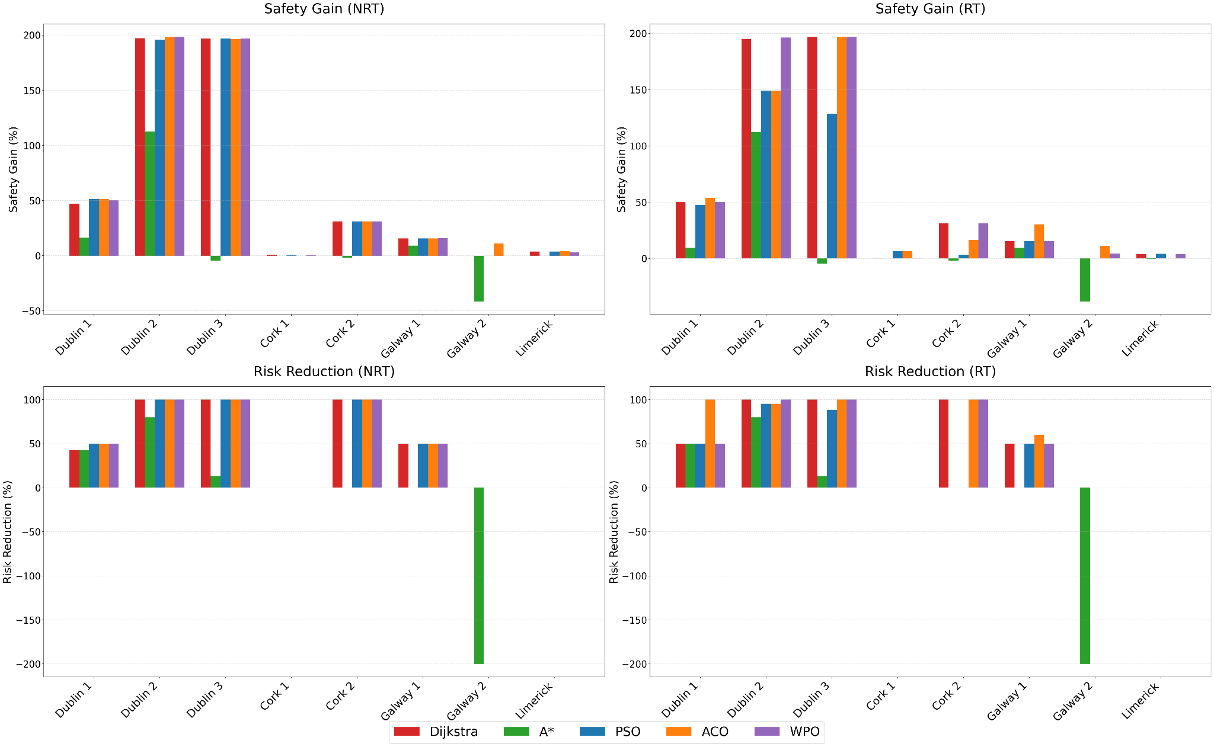
Results Chart
Notes:
The comparative charts highlight how individual algorithms behave across varied metropolitan geographies (Dublin, Cork, Galway, Limerick). While classical models show sharp variance and vulnerability to spatial bias, swarm implementations demonstrate stable risk reduction profiles.
WPO and ACO models demonstrate higher latency spikes under heavy convergence steps, whereas PSO exhibits linear scalability suitable for mobile app deployment.

Slide 13
Results discussion
Dijkstra: the strongest static baseline
Highest combined accuracy (~95%) and lowest runtime
~61% safety gain
~50% risk reduction in both configurations
RQ1: Real-Time Data Impact: Live vs Static Data Efficacy
RT integration continuously reshapes reliability profiles
Swarm e.g. PSO handle sparse data without collapsing.
Adapt quickly to changing network conditions.
No heavy re‑computation costs of classical global search trees.
A*: fast, but structurally unsuited to risk
Only algorithm with negative average risk reduction (-8%).
Great-circle heuristic biases search to "close" paths, not low-risk ones.
PSO: the most balanced choice for real-time
✗ Safety gain 61.9% (NRT) -> 44.3% (RT),
✓ RT lowest of 3 swarm methods - good trade-off under time pressure.
RQ2: Risk vs Distance Penalty: Safety vs Convenience Trade-off
Swarm routing disproved heavy trade‑off hypothesis
Achieved up to 63% safety‑risk reduction
Only 5%+ travel distance vs shortest‑path routing
Shows high safety gains with minimal efficiency cost
ACO & WPO: strong safety, weaker real-time fit
✓Both matched or exceeded Dijkstra's safety gains
✗ ACO: volatile runtime & WPO stayed consistently high
Notes:
●Real-time data affected all swarm algorithms differently.
●PSO adapted best for dynamic routing.
●ACO and WPO improved safety but increased computation.
●A* heuristic optimised distance rather than safety.
●Swarm algs improved safety without major increases in travel distance.

Slide 14
Conclusion and Future Work
Key conclusions
Real‑time data changes routing behaviour, directly affecting algorithm performance.
Swarm methods improve safety with very small distance increases.
Routes achieved >90% accuracy and up to 198% safety gains.
WPO gives the highest safety but is the slowest.
PSO provides the best real‑time balance of safety vs distance.
A* performs weakest, often producing unsafe “safest” routes.
Future work
• Integrate time-of-day into shortest/safest route decisions
• Connect a real-time API so routes update as conditions change
• Incorporate Road Safety Authority (RSA) accident data for greater coverage
• Test beyond the four largest cities to diversify results
• Add environmental & temporal factors (weather, roadworks) to routing

Slide 15
Challenges & Responsibilities
OSM alignment issues
Server instability
Occasional long runtimes
Ensuring pure swarming behaviour
Safety scoring limitations
Route sanity testing
Ben - Project idea; Solution framework design; Sourcing & cleaning collision/OSM data; Map‑based route selection; Algorithm implementation & testing.
Hemandh - Research of optimisation methods & technical foundations; Algorithm implementation & testing; Algorithm behaviour & performance differences.

Slide 16
References
[1] bru.webadmin, “Shared e-scooter and e-bike injury risk continues downward trend across Europe in 2025 - Micro-mobility for Europe,” Apr. 2026.
[2] E. Fernandez, “Electric Scooter and Bike Accidents Are Soaring Across the U.S.,” July 2024.
[3] G. Yannis et al., “Safer Micromobility: Technical Background Report,” 2024.
[4] S. Herr, “2024 State of the Industry Report,” Aug. 2025.
[5] T. Tamagusko et al., “Data-Driven Approach for Urban Micromobility Enhancement through Safety Mapping and Intelligent Route Planning,” Smart cities, vol. 6, no. 4, pp. 2035–2056, Aug. 2023
[6] M. Zakhem and J. Smith‐Colin, “An E-scooter route assignment framework to improve user safety, comfort and compliance with city rules and regulations,” Transportation Research Part A: Policy & Practice, vol 179, pp. 103930–103930, 2024
[7] T. Luo, et al, “An improved levy chaotic particle swarm optimization algorithm for energy efficient cluster routing scheme in industrial wireless sensor networks,” Expert Systems with Applications, vol. 241, p. 122780, Nov. 2023
[8] C. Liu et al., “AI-based 3D pipe automation layout with enhanced ant colony optimization algorithm,” Automation in Construction, vol. 167, pp. 105689–105689, Nov. 2024
[9] R. Mukha, et al, “Method and Software for Managing HR Processes of a Company using the Wolf Pack Algorithm,” 2024 14th International Conference on Advanced Computer Information Technologies (ACIT), pp. 376–379, 2024
[10] L. Yang, J. Yu, S. Yang, B. Wang, B. J. Nelson, and L. Zhang, “A Survey on Swarm Microrobotics,” IEEE transactions on robotics, vol. 38, no. 3, pp. 1531–1551, June 2022
[11] T. Patiño Padial, S. Chen, A. C. Hortelão, A. Sen, and S. Sánchez, “Swarming intelligence in self-propelled micromotors and nanomotors,” Nature Reviews Materials, vol. 10, no. 12, pp. 947–963, June 2025

